Slide 1
AUTOMATIC DETECTION OF DIABETIC RETINOPATHY AND ITS TYPE CLASSIFICATION USING GOOGLENET AND INCEPTION V3 ARCHITECTURES
A17 PROJECT WORK - FIRST REVIEW – (30/01/2023)
Presented By:
Guided By:
J.Bharghavi - 211419104041
H.Deepthi - 211419104052
B.Mathumita -211419104164
Ms.V.Sathiya
1

Slide 2
ABSTRACT:
Diabetic retinopathy (DR) is an eye disease that occurs when there is a damage in the retina as a result of long-term diabetes mellitus.
Too much sugar in the blood can lead to the blockage of the tiny blood vessels that nourish the retina, cutting off its blood supply. As a result, the eye attempts to grow new blood vessels.
These new blood vessels are ill-developed and can be leaked out easily.
To diagnose and detect diabetic retinopathy, numerous methods have been suggested.
Diabetic retinopathy detection involves three steps, mainly the pre-processing of the colored fundus images, diagnostic feature extraction, and classification of DR. So by using CNN algorithms, abnormalities can be found in the fundus images that determine whether a person has been diagnosed
with diabetic retinopathy.

Slide 3
BASE PAPER:
Title - Hybrid Retinal Image Enhancement Algorithm for Diabetic Retinopathy Diagnostic Using Deep Learning Model
Authors - Saif Hameed Abbood, Haza Nuzly Abdull Hamed, Mohd Shafry Mohd Rahim, Amjad Rehman, Tanzila Saba, and Saeed Ali Bahaj
Link - https://ieeexplore.ieee.org/document/9819926

Slide 4
LITERATURE SURVEY:
S.NO | YEAR | AUTHOR NAME | PAPER TITLE | METHODOLOGY | MERITS & DEMERITS | FUTURE SCOPE
1 | 2021 | Anas Bilal, Guangmin Sun, Yu Li, Sarah Mazhar, Abdul Qadir Khan | TITLE: Diabetic Retinopathy Diagnosis From Fundus Images Using Stacked Generalization of Deep Models JOURNAL: IEEE ACCESS VOLUME: 9 DATE OF PUBLICATION: January 19, 2021 | Three different sub-models of CNNs are fed into a single meta-learner classifier for feature extraction. Data augmentation technique is also applied to improve the diversity of images in the dataset. Finally, the meta-learner classifier produces the diagnostic result as healthy (No DR) or unhealthy (DR). | MERITS: This model reports an overall test accuracy of 97.92% in binary classification and 87.45% multi-class classification DEMERITS: The images of the model are available in the .JPEG format. Since it is a lossy compression, the images lose a significant amount of information. | For future work, we think of diversifying and increasing the images in the dataset for improving the feature extraction capabilities.

Slide 5
S.NO | YEAR | AUTHOR NAME | PAPER TITLE | METHODOLOGY | MERITS & DEMERITS | FUTURE SCOPE
2 | 2021 | Mohamed M.Abdel Salam, M.A.Zahran | TITLE: A Novel Approach of Diabetic Retinopathy Early Detection Based on Multifractal Geometry Analysis for OCTA Macular Images Using Support Vector Machine JOURNAL: IEEE ACCESS VOLUME: 9 DATE OF PUBLICATION: January 26, 2021 | Used a supervised machine learning method as a Support Vector Machine (SVM) algorithm to automate the diagnosis process and improving the resultant accuracy. | MERITS: The proposed technique has achieved an accuracy of 98.7% to detect Early Diabetic Retinopathy. DEMERITS: This model cannot detect the different stages of Diabetic Retinopathy. | Design a new GUI application that can extract the selected image features for early detection and diagnosis. The detection and extraction of malignant.

Slide 6
S.NO | YEAR | AUTHOR NAME | PAPER TITLE | METHODOLOGY | MERITS & DEMERITS | FUTURE SCOPE
3 | 2022 | Mohamed M.Farag, Mariam Foud, Amr T.Abdel-Hamid | TITLE: Automatic Severity Classification of Diabetic Retinopathy Based on DenseNet and Convolutional Block Attention Module. JOURNAL: IEEE ACCESS VOLUME: 10 DATE OF PUBLICATION: April 6, 2022 | The proposed technique employs DenseNet169’s encoder to construct a visual embedding. Convolutional Block Attention Module (CBAM) is introduced on top of the encoder to reinforce its discriminative power. The model is trained using cross-entropy loss on the Kaggle Asia Paciﬁc Tele-Ophthalmology Society’s (APTOS) dataset. | MERITS: Efﬁciently grades the severity level of diabetic retinopathy while reducing the time and space complexity. DEMERITS: The model cannot detect the types of Diabetic Retinopathy. | For future research direction, we evaluate the performance of different CBAM configurations. Moreover, experimenting with different imbalanced learning techniques and increasing the dataset size will lead to better performance.

Slide 7
S.NO | YEAR | AUTHOR NAME | PAPER TITLE | METHODOLOGY | MERITS & DEMERITS | FUTURE SCOPE
4 | 2019 | Zhentao Gao, Jie Li, Jixiang Guo,Yuanyuan Chen, Zhang Yi, Jie Zhong | TITLE: Diagnosis of Diabetic Retinopathy Using Deep Neural Networks Publisher: IEEE Cite This PDF Jadoon JOURNAL:IEEE ACCESS VOLUME: 7 DATE OF PUBLICATION: 19 December 2019 | In this paper, new dataset of fundus images are used for grading DR. In contrast to existing scales that grade fundus images mainly by the pathological changes in the retina. With this dataset, several deep convolutional neural network (DCNN) models were trained for the diagnosis of DR. | MERITS: With this dataset, several deep convolutional neural network (DCNN) models were trained for the diagnosis of DR. Our models were also deployed for clinical evaluation in several hospitals DEMERITS: The I/O operation for reading the images from the disk takes a lot of time | In the future, data from more equipments will be included, and a broader pilot study will be launched. The accumulated data will be further used to improve the accuracy of the models.

Slide 8
S.NO | YEAR | AUTHOR NAME | PAPER TITLE | METHODOLOGY | MERITS & DEMERITS | FUTURE SCOPE
5 | 2022 | Hamza Mustafa, Syed Farooq Ali, Muhammad Bilal, Muhammad Shehzad Hanif | TITLE: Multi-Stream Deep Neural Network for Diabetic Retinopathy Severity Classification Under a Boosting Framework JOURNAL:IEEE ACCESS VOLUME: 10 DATE OF PUBLICATION: October 26, 2022 | This paper presents a multi-stream deep neural network for classification and grading of diabetic retinopathy using EyePACS, Messidor-2, APTOS, and DDR datasets using 2, 3 and 5 categories. Our approach used two streams of inputs in the form of features extracted from the two deep networks. | MERITS: The proposed approach achieves superior performance (95.58% accuracy) and can be considered a promising method for automatic diabetic retinopathy detection. DEMERITS: However, the model only detects two categories of diabetic retinopathy. | In future, to increase the accuracy of our proposed approach is to work in an uncontrolled environment. We will replace the current dimensionality reduction PCA technique with auto encoders.

Slide 9
S.NO | YEAR | AUTHOR NAME | PAPER TITLE | METHODOLOGY | MERITS & DEMERITS | FUTURE SCOPE
6 | 2021 | Sharmin Majumder, Nasser Kehtarnavaz | TITLE: Multitasking Deep Learning Model for Detection of Five Stages of Diabetic Retinopathy JOURNAL:IEEE ACCESS VOLUME: 9 DATE OF PUBLICATION: August 31, 2021 | In this paper, a multitasking deep neural network is developed to classify all the five stages of diabetic retinopathy from eye fundus images based on the DenseNET architecture. The largest publicly available datasets of eye fundus images (EyePACS and APTOS datasets) were used to train and evaluate the developed model. | MERITS: The proposed approach considered of two or more classification models DEMERITS: However, the accuracy of the model is less when considering all the stages of diabetic retinopathy | A possible future extension of this work includes the real-time implementation of this model as a smartphone app so that it can easily be deployed in clinical environments for diabetic retinopathy eye examination.

Slide 10
S.NO | YEAR | AUTHOR NAME | PAPER TITLE | METHODOLOGY | MERITS & DEMERITS | FUTURE SCOPE
7 | 2021 | Zubair Khan, Fiaz Gul Khan , Ahmad Khan, Zia Ur Rehman, Sajid Shah, Sehrish Qummar , Farman Ali, Sangheon Pack | TITLE: Diabetic Retinopathy Detection Using VGG-NIN a Deep Learning Architecture JOURNAL:IEEE ACCESS VOLUME: 9 DATE OF PUBLICATION: April 20, 2021 | In this paper, architectural changes are done in the existing CNN to enhance the efficiency and accuracy of classification of the DR stages in color fundus images and reduce the number of learnable parameters. Imbalanced versions of the Kaggle dataset is used to validate the performance measures of the proposed model. | MERITS: The results depict low in computation and better than other state-of the-art ensemble and non-ensemble methods. DEMERITS: The drawback of the ensemble model is the number of learnable parameters. | In the future, they plan to bring some other productive changes in the existing model’s architecture and some preprocessing techniques and discuss how these changes affect the working of a model on the classification of DR’s stages, especially the early ones.

Slide 11
S.NO | YEAR | AUTHOR NAME | PAPER TITLE | METHODOLOGY | MERITS & DEMERITS | FUTURE SCOPE
8 | 2021 | Fahman Saeed, Muhammad Hussain, Hatim A. Aboalsamh | TITLE:Automatic Diabetic Retinopathy Diagnosis Using Adaptive Fine-Tuned Convolutional Neural Network. JOURNAL:IEEE ACCESS VOLUME: 9 DATE OF PUBLICATION: March 10, 2021 | The system was built on a pre-trained model using a two-stage transfer learning method. First, the CNN models are pre-trained on Image Net. Second, the FC layers encoded the high-level features relevant to the natural images and have a very large number of learnable parameters. | MERITS: The FC layers has a very large number of learnable parameters, encoded the high-level features pertinent to the natural images. DEMERITS: The model did not employ any preprocessing or enhancement step. | Future work will focus on how the model can accurately predict the DR level from poor quality, extremely low contrast, and saturated fundus images.

Slide 12
S.NO | YEAR | AUTHOR NAME | PAPER TITLE | METHODOLOGY | MERITS & DEMERITS | FUTURE SCOPE
9 | 2019 | Xianglong Zeng, Haiquan Chen, Yuan Luo, and Wenbin Ye | TITLE:Automated Diabetic Retinopathy Detection Based on Binocular Siamese-Like Convolutional Neural Network. JOURNAL:IEEE ACCESS VOLUME: 7 DATE OF PUBLICATION:March 5, 2019 | A novel CNN model to automatically detect RDR based on the deep learning method is developed. | MERITS: Great potential to diagnose RDR more efficiently and improve the screening rate of RDR. DEMERITS: The binocular models will have difficulties in training or testing with other dataset in which paired fundus images are unavailable | The performance of model can be further improved if more data are collected in the future.

Slide 13
S.NO | YEAR | AUTHOR NAME | PAPER TITLE | METHODOLOGY | MERITS & DEMERITS | FUTURE SCOPE
10 | 2021 | Tieyuan Liu, Yi Chen, Hongjie Shen, Rupeng Zhou, Meng Zhang, Tonglai Liu, And Jin Liu | TITLE: A Novel Diabetic Retinopathy Detection Approach Based on Deep Symmetric Convolutional Neural Network. JOURNAL:IEEE ACCESS VOLUME: 9 DATE OF PUBLICATION: November 30, 2021 | The research is based on a symmetric convolutional structure to detect differ- ent kinds of lesions in diabetic retinal images. The symmet- rical convolutional structure can extract more complex lesion features and significantly improve detection performance. | MERITS: The overall accuracy of the pooling operation is higher than that of the convolutional operation. DEMERITS: Difficult to detect more objects simultaneously in DR images | In future, further modifications can be done to the model to detect more objects simultaneously and accurately in diabetic retinopathy images.

Slide 14
PROBLEM STATEMENT :
Numerous methods have been suggested to diagnose and detect diabetic retinopathy.
They could determine whether a person is affected by diabetic retinopathy or not along with the severity level of DR, if affected.
Diabetic Retinopathy can be classified into three types and the existing methods could not specifically determine the type of DR of the affected person.
This issue can be solved by using another CNN model to detect the type of Diabetic Retinopathy in addition to the CNN model which detects only the presence of DR in the retinal image.

Slide 15
EXISTING SYSTEM:
In the existing system, they present an algorithm for improving the quality of images to strengthen the standard of color fundus images by reducing noise and improving contrast.
The approach includes two main stages: cropping the images to remove insignificant content, followed by applying the shape crop and gaussian blurring for noise reduction and contrast improvement.
Finally, the ResNet50 model is used for feature extraction and classification of enhanced DR images.
DISADVANTAGES OF EXISTING SYSTEM:
The existing system cannot determine the specificity of DR types.
The ResNet50 model was used for feature extraction and classification, which increased time consumption.

Slide 16
PROPOSED SYSTEM:
Preprocessing eliminates irrelevant details from images and enhances their quality to help make better decisions. A Median Filter for noise removal and Adaptive Histogram Equalization for image enhancement are proposed.
Classification step is implemented by GoogleNet CNN model, to quickly classify retinal images into normal and abnormal retinal images.
Using Inception V3, three kinds of DR in the retina are classified : Microaneurysms, Haemorrhages, and Exudates.
ADVANTAGES OF PROPOSED SYSTEM:
The proposed system can determine the specific type of DR in abnormal retinal images.
The rate of classification accuracy is high due to image pre-processing techniques.
The processing speed is high , so it consumes less computational time.

Slide 17
OVERVIEW OF PROCESS:
Image Acquisition
Image Pre-processing
GoogleNet model for Retinal image Classification
DR type classification using Inception V3
Finally get DR classified result

Slide 18
SYSTEM ARCHITECTURE:
Input Retinal Image
Dataset Images (Normal & Abnormal )
Preprocessing ( Noise Removal By Median & AHE )
Preprocessing (noise removal)
Training Using GoogleNet
Classification Using GoogleNet CNN
Trained Network Model
Normal
Abnormal (DR)
Different Types Of DR Images
Preprocessing (noise removal)
Preprocessing (noise removal)
Classification Of DR Retinal Images Using Inception V3
Training Using Inception V3
Trained Network Model
Classified DR Results

Slide 19
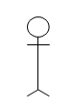
USE CASE DIAGRAM:
Image Acquisition
Image Pre -Processing
Retinal Image Classification
System
DR type classification
Doctor
DR Result

Slide 20
Sequence diagram:
SYSTEM
DOCTOR
1.Image Acquistion
2.Pre-processing
3.GoogleNet Model for Retinal Image Classification
4.DR Classification using Inception V3
5.DR Result

Slide 21
Activity diagram :
SYSTEM | DOCTOR
Image Acquistion
Pre-processing
GoogleNet Model for Retinal Image Classification
DR Classification using Inception V3
DR result

Slide 22
Data Flow Diagram :
Level 0 :
Retinal Image
Processed Image
Predicted Output
Image Pre-processing
Dataset Folder
CNN Model
Developer

Slide 23
Level 1 :
Retinal Image
Processed Image
Classification as normal & abnormal images
Dataset Folder
Image
Pre-processing
Retinal Image
Classification of DR types
Predicted Result
Developer

Slide 24
Level 2 :
Retinal Images
Processed Images
Image
Pre-processing
Training GoogleNet
Dataset Folder
Processed Image
GoogleNet Model
Inception V3 Model
Developer
Abnormal Image
DR Type Result
Image Pre-processing
Training Inception V3
Abnormal Retinal Images
Processed Images

Slide 25
MODULES:
Image Acquisition
Image Pre-processing
Classification of Retinal Image
Classification of Diabetic Retinopathy

Slide 26
IMAGE ACQUISITION:
Image acquisition in image processing can be broadly defined as the action of retrieving an image from some source, so it can be passed through whatever processes need to occur afterward.
Retinal images are collected from Kaggle public database.
These retinal images are passed for pre-processing.

Slide 27
PRE-PROCESSING DATASET:
Pre-processing includes noise removal and contrast enhancement.
Median filter is an algorithm used to remove the noise in the retinal image.
Image contrast is enhanced by the Adaptive Histogram Equalization (AHE) process.
Adaptive histogram equalization (AHE) is a computer image processing technique used to improve contrast in retinal images.

Slide 28
CLASSIFICATION OF RETINAL IMAGES :
Following pre-processing, a GoogleNet CNN model is used to extract features and classify retinal images.
GoogleNet has 22 layers, and the input size is 224 by 224 pixels.
Based on the hyperparameters such as epochs, learning rate, dropout, and optimizer (ADAM), the proposed model is trained to build a classification prediction that classifies the retinal image into normal and abnormal (diabetic retinopathy) retinal image.

Slide 29
CLASSIFICATION OF DIABETIC RETINOPATHY:
In this module, abnormal retinal images (DR) are carried out to classify the diabetic retinopathy images into three types using Inception V3 deep learning model.
Inception V3 has 42 layers, and the input size is 299 by 299 pixels.
Based on the hyperparameters such as epochs, learning rate, dropout, and optimizer (ADAM), the proposed model was trained to build a classification prediction that classifies the DR retinal image into three types, such as microaneurysms, haemorrhages, and exudates.

Slide 30
ALGORITHM:
Algorithm for Pre Processing
Load the dataset
Use median filter for noise removal
Enhance Image contrast into high contrast by the adaptive histogram equalization (AHE)
Algorithm for Detection
Train GoogleNet model by passing pre-processed images
Extract features
Classify the retinal images as normal or DR
Algorithm for Classification
Train Inception V3 model using dataset
Classify the DR as : Microaneurysm,Haemorrhage,Exudate
Display the final prediction

Slide 31
ALGORITHM DESCRIPTION:
MODULE DESCRIPTION:
GoogLeNet:
GoogLeNet is a 22-layer deep convolutional neural network that’s a variant of the Inception Network.
Google Net (or Inception V1) was proposed by research at Google in 2014 in the research paper titled “Going Deeper with Convolutions” which has provided a significant decrease in error rate as compared to previous winners AlexNet and ZF-Net and significantly less error rate than VGG.
This architecture uses techniques such as 1×1 convolutions in the middle of the architecture and global average pooling.
The GoogLeNet architecture is very different from previous state-of-the-art architectures such as AlexNet and ZF-Net as it uses many different kinds of methods such as 1×1 convolution and global average pooling that enables it to create deeper architecture.

Slide 32
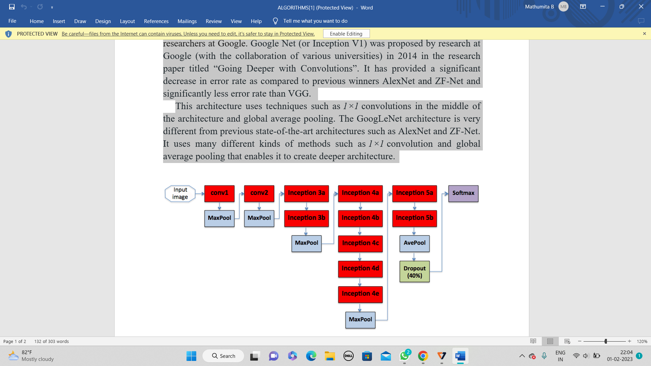
GOOGLENET ARCHITECTURE:

Slide 33
Inception V3:
ALGORITHM DESCRIPTION:
The Inception V3 is a deep learning model based on Convolutional Neural Networks, that is used for image classification. The inception V3 is a superior version of the basic model Inception V1 in 2014.The inception V3 is just the advanced and optimized version of the inception V1 model. The Inception V3 model uses several techniques for optimizing the network for better model adaptation.
It has higher efficiency.
It has deeper network compared to the Inception V1 and V2 models, but its speed isn't compromised.
It is computationally less expensive.
It uses auxiliary Classifiers as regularizes.

Slide 34
The inception v3 model was released in the year 2015, it has a total of 42 layers and a lower error rate than its predecessors. The major modifications done on the Inception V3 model are
Factorization into Smaller Convolutions
Spatial Factorization into Asymmetric Convolutions
Utility of Auxiliary Classifiers
Efficient Grid Size Reduction

Slide 35
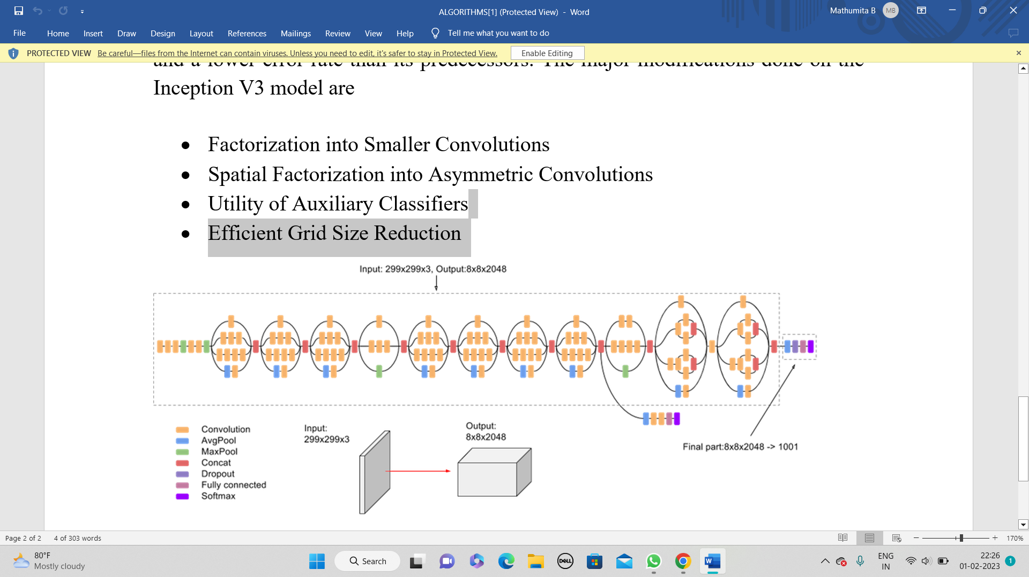
INCEPTION V3 ARCHITECTURE:

